Slide 1

AI CUSTOMER SUPPORT AUTOMATION
Autonomous ticket triage, AI-drafted responses, and a human review gate — built end-to-end in n8n
Petalnex AI Automation Internship — Final Capstone Presentation
Sajeel Ali · Day 36 — Final Presentation & Demo Day

Slide 2

The Business Problem
Petalnex is a project-based software, AI, and digital-services company — every client engagement generates a steady stream of support requests spanning technical issues, integrations, billing, and project-status questions.
No consistent triage
No systematic reuse
Every ticket is read and categorized manually — quality depends on who happens to pick it up.
Answers already documented internally aren’t surfaced automatically; agents re-derive the same solutions.
No risk-based routing
No input screening
Urgent, frustrated, or sensitive tickets get no priority over routine ones.
Nothing checks a submission for malicious content before a human or system acts on it.
Petalnex — AI Automation Internship | AI Customer Support Automation
2

Slide 3

The Existing Process (Manual)
Client emails or messages a request
Support staff reads it manually
Staff manually searches docs / memory for a fix
Staff manually drafts and sends a reply
Pain points this creates
Slow first response — tickets wait in a shared inbox until someone is free
Inconsistent categorization and priority, since it depends entirely on the reader’s judgment
Tribal knowledge dependency — the best answer often lives in one person’s memory
No security screening — malicious or malformed input is treated the same as a normal question
Petalnex — AI Automation Internship | AI Customer Support Automation
3

Slide 4




The Proposed Solution
An end-to-end n8n workflow that validates, classifies, retrieves, and drafts a reply automatically — and routes anything sensitive to a human before it ever reaches the client.
1
2
3
4
Validate & Store
Classify & Prioritize
Retrieve & Draft
Human Review Gate
Normalize and validate the submission before it costs anything
Gemini assigns category, sentiment, priority, and screens for injection
Supabase pgvector retrieves KB context; Gemini drafts the reply
Anything sensitive pauses for a reviewer before the client sees it
Petalnex — AI Automation Internship | AI Customer Support Automation
4

Slide 5

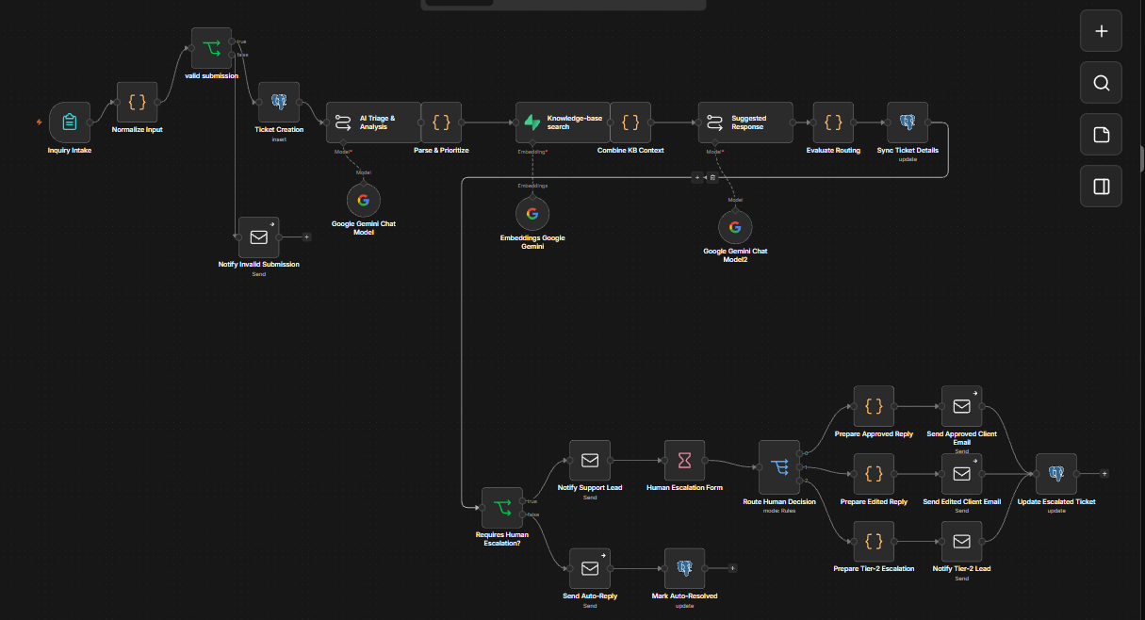
System Architecture

Slide 6

Technologies & Tools
Orchestration
n8n (self-hosted)
Deterministic core + AI nodes + human-in-the-loop Wait/Form node, all in one workflow
Database
Supabase / Postgres
Ticket storage, updates matched on id, Transaction pooler (port 6543) for reliable SSL
Vector search
pgvector + Supabase Vector Store
`support_kb` table queried via the `match_support_kb` RPC function
AI models
Google Gemini
Chat model for triage / sentiment / response drafting; `gemini-embedding-001` for embeddings
Notifications
Gmail (SMTP / OAuth2)
Client replies, support-lead alerts, and tier-2 escalation emails
Version control
GitHub
Full workflow JSON, documentation, and daily progress reports
Petalnex — AI Automation Internship | AI Customer Support Automation
6

Slide 7
Workflow Stage 1 — Intake & Validation
Deterministic Core
Inquiry Intake
(Form Trigger)
Normalize Input
(Code)
valid submission?
(IF)
Ticket Creation
(Postgres Insert)
Why validate before AI runs
Design decision
Trims and normalizes client_name, client_email, project_name, and message
Rejects a submission if the name is missing, the email fails a format check, or the message is under 15 characters
A rejected submission never reaches the AI layer — it goes straight to Notify Invalid Submission instead
Every field is checked deterministically in plain code before a single Gemini call is made. Bad data is caught for free — no wasted AI spend, and no malformed record ever reaches Postgres.
Petalnex — AI Automation Internship | AI Customer Support Automation
7

Slide 8

AI Classification, Sentiment & Security
Categories (Gemini)
Dual-layer injection & XSS defense
Technical Issue
Integration / API
Project Status
Bug Report
Feature Request
Billing
Layer 1 — Gemini itself is prompted to scan every field for XSS tags, SQL injection, or prompt-injection patterns and set is_injection: true if found
Layer 2 — a regex safety net independently re-checks the raw message for patterns like DROP TABLE, UNION SELECT, <script>, or exec(
Either layer alone is enough to flip category to "Security / Malicious Input" and priority to High — no single point of failure
General Inquiry
Security / Malicious Input
(override — forces High priority)
Sentiment & priority
Sentiment: Frustrated, Neutral, or Positive, plus a 0–100 sentiment_score
Priority: High, Medium, or Low, assigned alongside the category
Petalnex — AI Automation Internship | AI Customer Support Automation
8

Slide 9

Priority Detection & Ticket Update
Parse & Prioritize
Parse & Prioritize (Code)
Sync Ticket Details (Postgres Update)
Extracts the LLM’s JSON response defensively, matching the first {...} block and falling back to null on parse failure
Re-applies the regex injection check as a safety net, independent of what the model reported
Defaults priority to Low and category to General Inquiry only when nothing overrides them
Attaches a reasoning string to every ticket, so every triage decision is auditable
Writes category, sentiment, priority, and the AI-suggested response back onto the same ticket row
Matched on the ticket’s id, not client_email — safe for repeat clients with multiple open tickets
Escalation logic (Evaluate Routing)
Escalates when ANY of these are true:
is_injection is true, or category is Security / Malicious Input
priority is High, or sentiment is Frustrated
category is anything other than General Inquiry
Petalnex — AI Automation Internship | AI Customer Support Automation
9

Slide 10
Knowledge-Base Retrieval (RAG)
RAG Layer
Parse &
Prioritize
Knowledge-base
search
(Supabase Vector Store)
Combine KB
Context
Table
public.support_kb — 10 seeded Petalnex knowledge-base entries
Embeddings
models/gemini-embedding-001, indexed at 3072 dimensions in pgvector
Query function
match_support_kb RPC, called by n8n’s Supabase Vector Store node
Retrieval
Top-K 3 nearest KB entries returned per ticket message
Petalnex — AI Automation Internship | AI Customer Support Automation
10

Slide 11

AI-Suggested Response Generation
Suggested Response
How the draft is written
When injection is detected
Gemini is given the client message, category, injection flag, and the retrieved KB context together
If the KB context covers the question, it drafts a concise, friendly resolution grounded in that context
If the KB doesn’t cover it, the model acknowledges the message and says a specialist is reviewing — it never invents an answer
Output is required to be plain text only, never JSON, so it can be dropped straight into an email body
The model is instructed to skip a normal reply entirely and output a fixed warning instead — it never echoes or engages with the malicious payload:
"WARNING: The client is attempting to inject scripts or malicious SQL payload. Do not execute or copy unchecked parameters."
Petalnex — AI Automation Internship | AI Customer Support Automation
11

Slide 12
Human Review Gate & Decision Routing
Requires Human Escalation? (IF)
Yes — Human Escalation Form
Security risk, High priority, Frustrated sentiment, or any non-General category → routed to a human
Everything else auto-resolves with no human involved
Notify Support Lead sends the full ticket context plus the AI-drafted reply
An n8n Wait node opens a resumable review form and pauses the workflow
No — Auto
Reviewer picks one of three decisions:
Approve Suggested
Response
Edit and Send
Escalate to
Team Lead
Send Auto-Reply
Mark Auto-
Resolved
Form also captures the reviewer’s name, an edited response (if applicable), and free-text review notes.
Petalnex — AI Automation Internship | AI Customer Support Automation
12

Slide 13

Escalation Outcomes & Notifications
Route Human Decision
Approve Suggested Response
Edit and Send
Escalate to Team Lead
Prepare Approved Reply
Prepare Edited Reply
(uses reviewer’s text)
Prepare Tier-2
Escalation
Send Approved Client Email
Send Edited Client Email
Notify Tier-2 Lead
Update Escalated Ticket (Postgres — records reviewer, decision & notes)
All three decision paths converge on one Postgres update — closing the loop with exactly what the reviewer decided and why.
Petalnex — AI Automation Internship | AI Customer Support Automation
13

Slide 14

Live Demo Walkthrough
1
Scenario 1: Routine billing question
Auto-classified as low-risk → KB-grounded reply drafted → sent automatically. No human touches this ticket.
2
Scenario 2: Frustrated, high-priority bug report
Escalated → support lead notified with full context → reviewer approves or edits in the form → client email sent.
3
Scenario 3: Malicious payload in the message field
Flagged Security / Malicious Input by both AI and regex → generic safe warning drafted → forced to Team Lead. Never treated as a normal question.
Petalnex — AI Automation Internship | AI Customer Support Automation
14

Slide 15

Error Handling & Reliability
Validate before spending
No single point of failure on security
The deterministic gate in Normalize Input rejects bad submissions before any AI call is made — no wasted Gemini spend on data that was never going to be usable.
A regex safety net independently re-checks for injection patterns, so a security classification never rests on the LLM’s judgment alone.
Defensive JSON parsing
Safe, targeted updates
Parse & Prioritize extracts the LLM’s JSON with a regex match and a try/catch, falling back to safe defaults instead of crashing the run on a malformed response.
Every Postgres update is matched on the ticket’s id, never on client_email — so concurrent tickets from the same client can’t overwrite each other.
Petalnex — AI Automation Internship | AI Customer Support Automation
15

Slide 16
Security & Credential Management
Input & content safety
Where credentials live
Two independent checks (Gemini + regex) before a message is trusted
Injection-flagged tickets never get a "helpful" AI answer — only a fixed warning, and they’re force-routed to a human
AI is never allowed to auto-send on a flagged ticket — the review gate is mandatory for anything suspicious
Gmail (SMTP / OAuth2), Supabase, and the Gemini API key are all stored in n8n’s built-in credential store — never hardcoded inside a node
Supabase connects over the Transaction pooler (port 6543) for a reliable SSL chain
Permissions on support_kb are granted explicitly to anon / authenticated / service_role, with row-level security disabled only on that KB table — not the ticket data
Petalnex — AI Automation Internship | AI Customer Support Automation
16

Slide 17


Business Benefits
Faster response for routine tickets
Consistent triage, every time
General inquiries auto-resolve immediately — no waiting on a human at all.
Category, sentiment, and priority no longer depend on who reads the ticket first.
Knowledge reused automatically
Human attention where it matters
KB answers are retrieved and drafted into replies instead of being re-typed by hand.
Reviewers only see tickets that are actually risky, urgent, frustrated, or complex.
Petalnex — AI Automation Internship | AI Customer Support Automation
17

Slide 18


Limitations & Future Improvements
Current limitations
Future improvements
Fixed set of 7 categories plus one security override — doesn’t adapt to new ticket types on its own
Single-channel intake — only the form trigger, no email/Slack/WhatsApp yet
Top-K 3 retrieval can miss an edge-case KB entry on ambiguous questions
Prompts and replies are English-only
Multi-channel intake (email, Slack, WhatsApp) feeding the same core pipeline
SLA timers with auto-escalation if a human review sits too long
An analytics dashboard on category, sentiment, and escalation trends
Expanding KB coverage and tuning Top-K for stronger retrieval
Petalnex — AI Automation Internship | AI Customer Support Automation
18

Slide 19

Thank You
Questions & Live Demo
github.com/SajeelALi2023632/petalnex-ai-automation-internship
Sajeel Ali · Petalnex AI Automation Internship · Day 36

